Slide 1






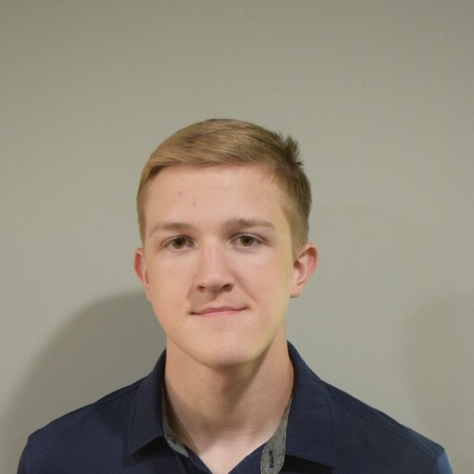




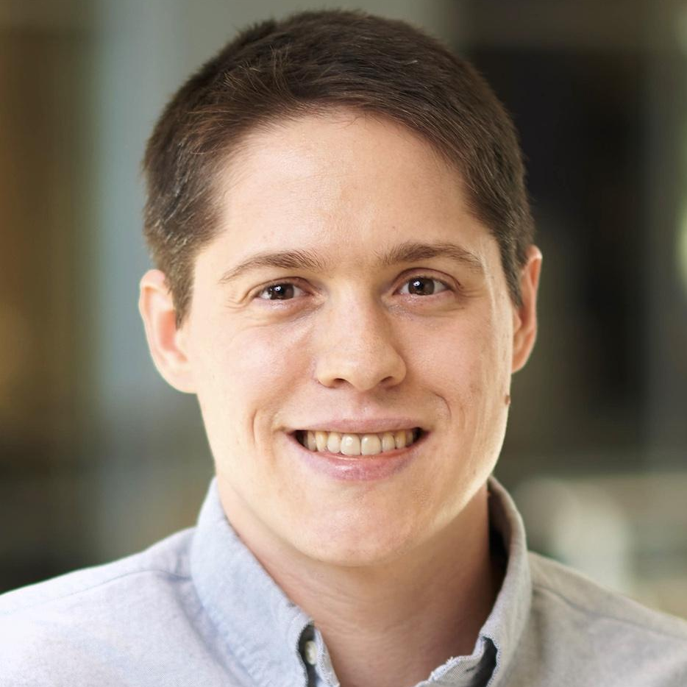







PeaTMOSS: A Dataset and Initial Analysis of Pre-Trained Models in Open-Source Software
Wenxin Jiang
Jerin Yasmin
Jason Jones
Nicholas Synovic
Nathaniel Bielanski
Jiashen Kuo
Yuan Tian
George K. Thiruvathukal
James C.
Davis
Notes:
Hi my name is Wenxin Jiang from Purdue University
Today I will present our MSR paper: “PeaTMOSS: A Dataset and Initial Analysis of Pre-Trained Models in Open-Source Software”.

Slide 2
Contributions
A SQL database including 281K PTM packages and 28K downstream GitHub repositories.
Extract unstructured metadata by a LLM-based tool
Provide the initial analysis of PTM supply chain
Assess PTM license compatibility with downstream GitHub repositories

Slide 3
Background and Motivation

Slide 4

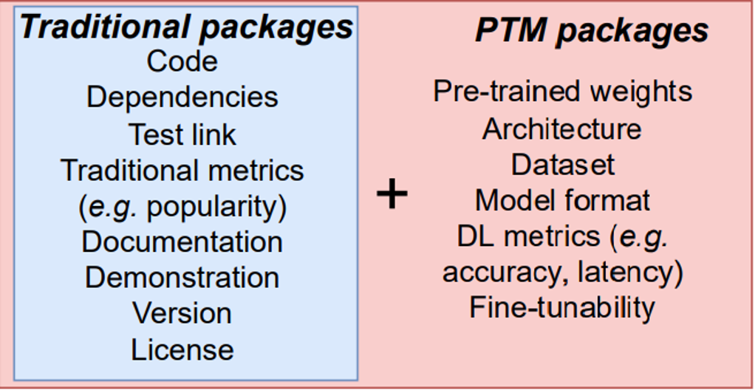




Pre-Trained Model (PTM) Package
PTM =
[1] Jiang, Wenxin, et al. "An empirical study of pre-trained model reuse in the hugging face deep learning model registry." 2023 IEEE/ACM 45th International Conference on Software Engineering (ICSE). IEEE, 2023.

Slide 5
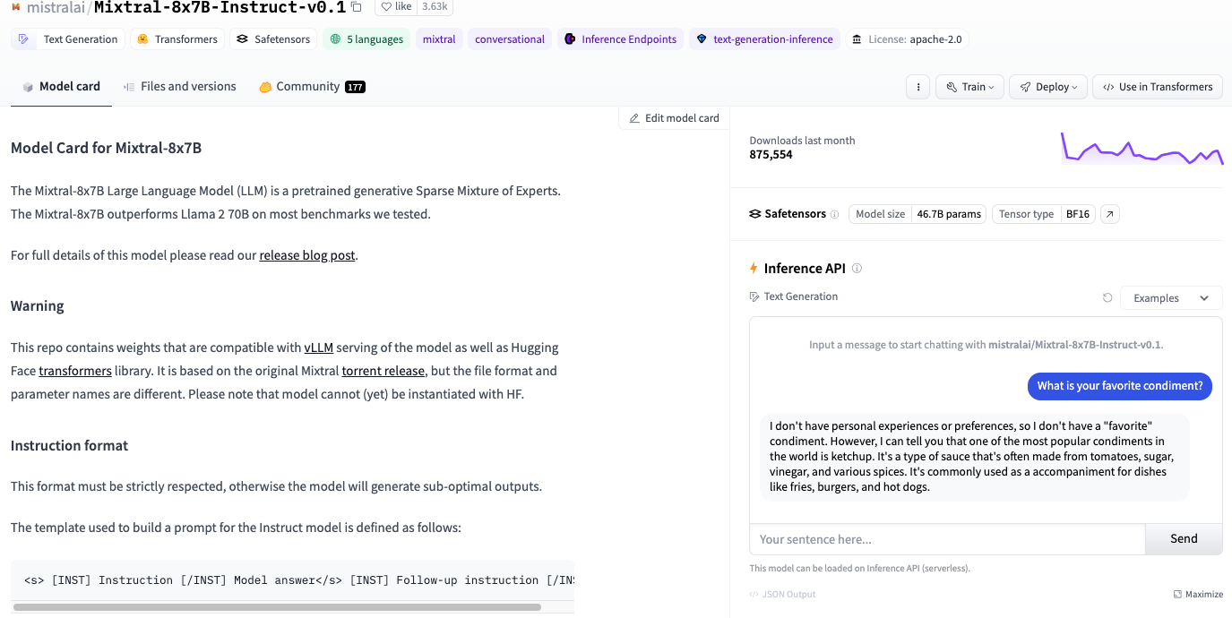
Pre-Trained Model (PTM) Package

Slide 6
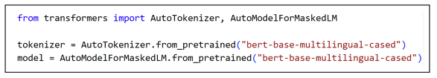

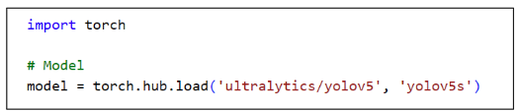

Example Usage of PTM Package
Reuse Cases:
Direct deployment
Model fine-tuning
Dataset generation
…
Notes:
Model reuse:
Direct deployment
Model fine-tuning
Dataset generation

Slide 7

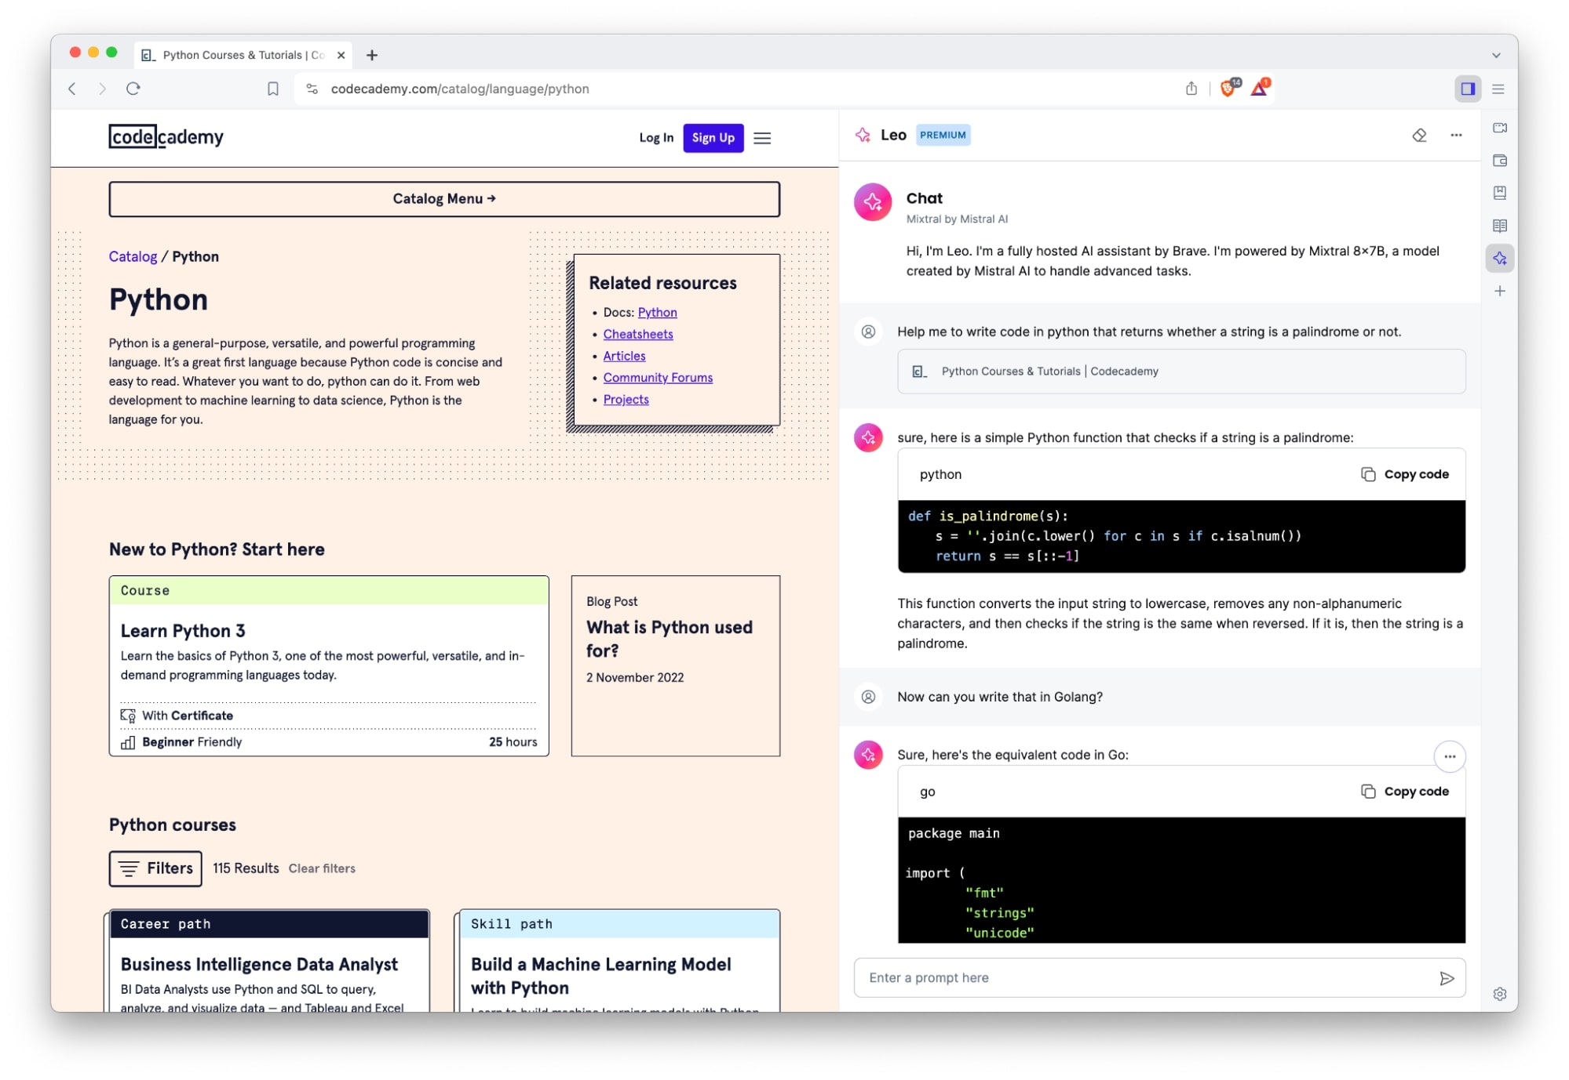
Example Usage of PTM Package
Leo AI Assistant
Notes:
Leo is the AI chat assistant which is a relatively new feature developed by brave
Brave: one of the most popular free and open-source web browser

Slide 8
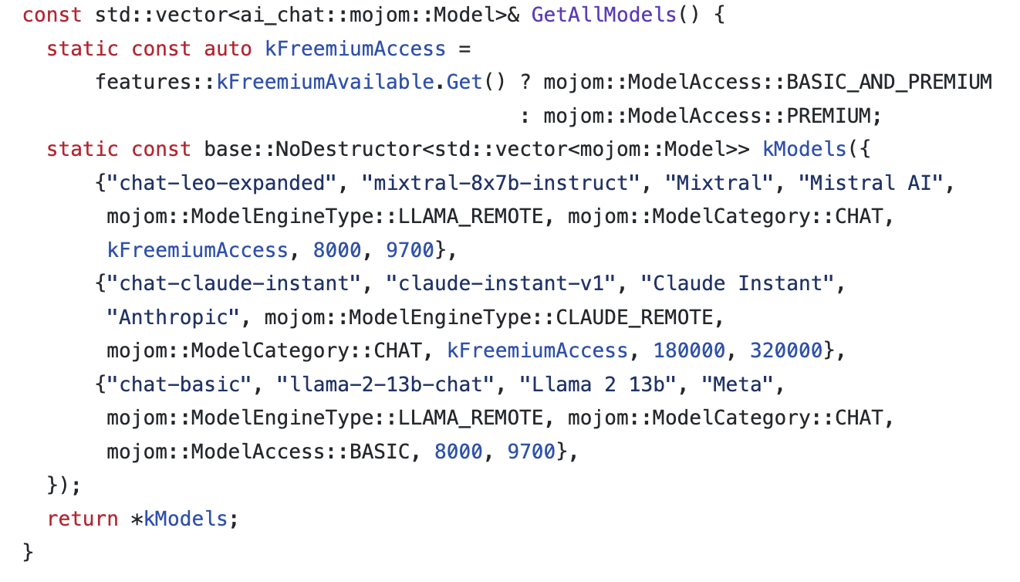

Example Usage of PTM Package
Notes:
Leo is the AI chat assistant which is a relatively new feature developed by brave
Brave: one of the most popular free and open-source web browser

Slide 9
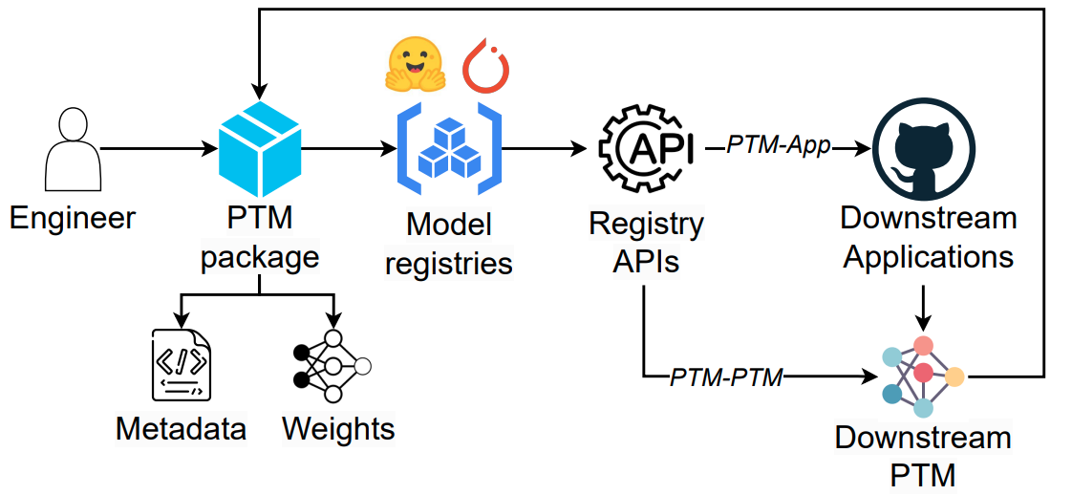
PTM Supply Chain
Popularity keeps increasing!
Time
# Packages
# Downloads (top 10%)
Aug. 2022
124 K
269 Million
Aug. 2023
282 K
587 Million

Slide 10
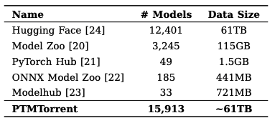
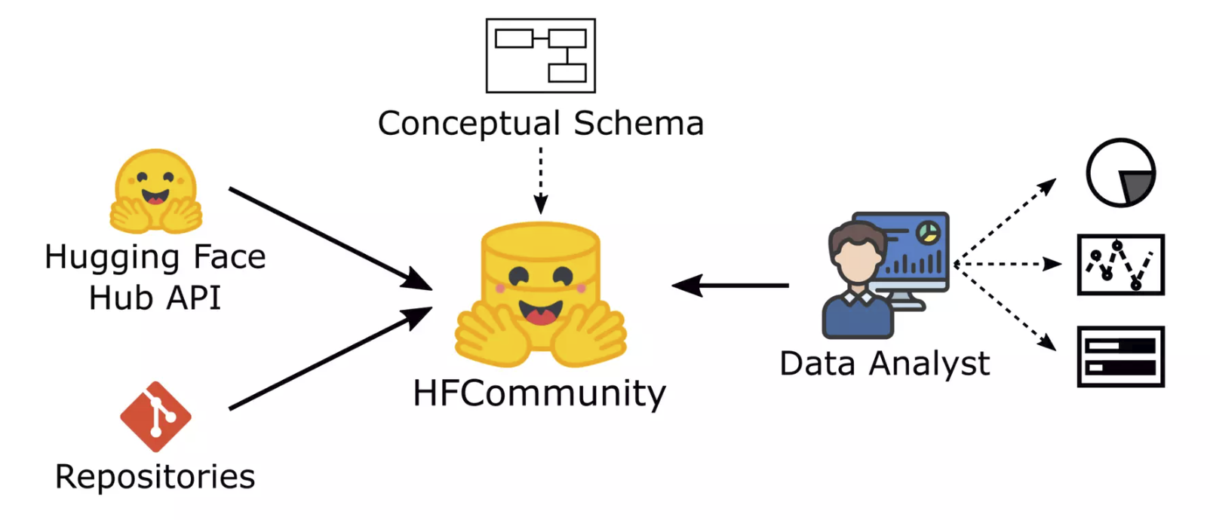
Existing Datasets
PTMTorrent
[Jiang et al. MSR’23]
HFCommunity
[Ait et al. SANER’23]
Gaps:
Lack of queryable/standardized PTM metadata across multiple hubs.
The downstream applications (GitHub) of PTM supply chain was missing in the existing datasets.
Lack of measurements on PTM supply chain.

Slide 11
PeaTMOSS Dataset

Slide 12
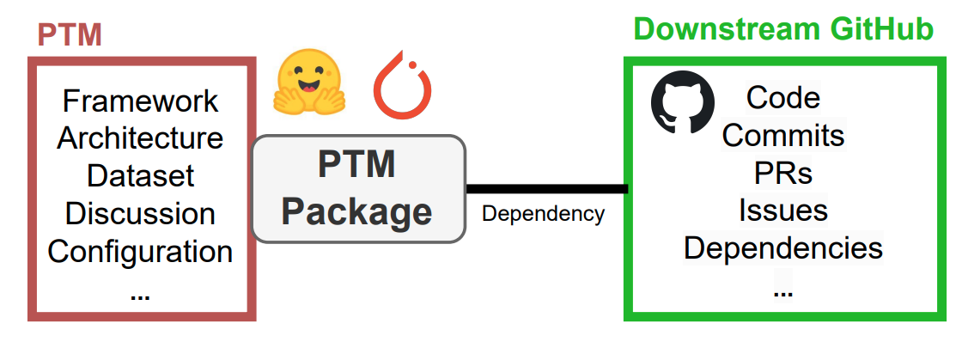
Pre-Trained Models in Open-Source Software
The PeaTMOSS dataset
“Lite”: 8 GB (metadata only)
“Full” : 48 TB including model weights and history

Slide 13
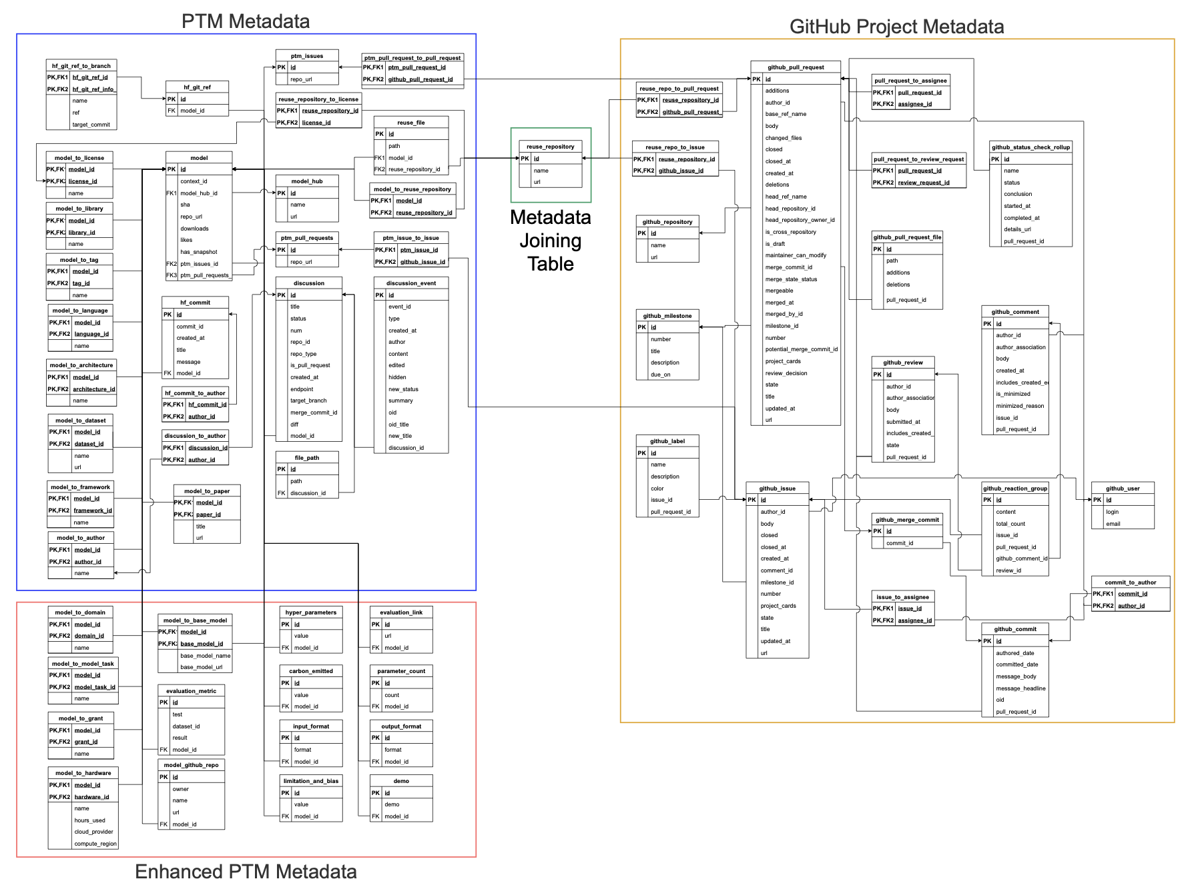
DB Schema - Overview
PTM Metadata
GitHub Application Metadata
Enhanced PTM Metadata
Mapping table
Notes:
Here is the overview of our database schema.
PTM Metadata, Mapping table connecting the upstream PTM package to downstream GitHub Applications, GitHub Application metadata, Enhanced PTM metadata.
I understand that this is hard to read… Let me give you more details.

Slide 14
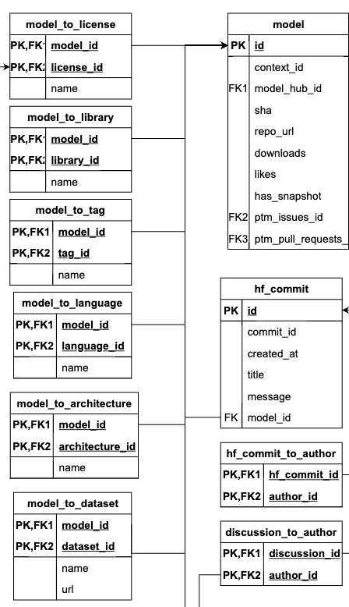
DB Schema – Basic PTM Metadata
Example metadata:
Downloads
Commits
Authors
License
Library
Model tag
Language
Architecture
Dataset
…

Slide 15
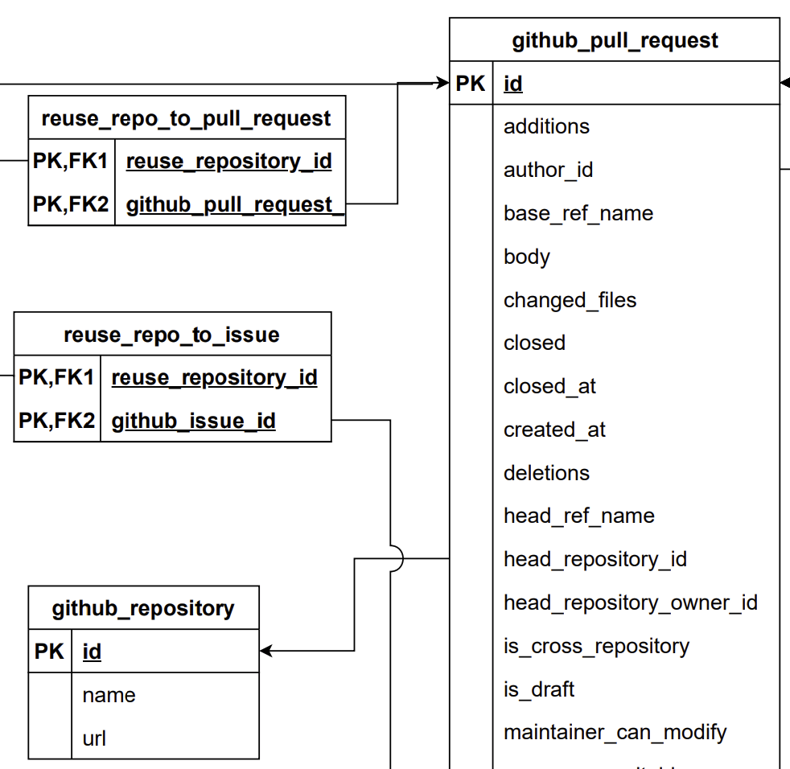
DB Schema - GitHub Project Metadata
Example metadata:
PRs
Issues
Commits
Label
License
…
Notes:
We have detailed information of PRs, issues, commits. For example, for each PR, our database include all text data, timeline, file changes, etc.

Slide 16
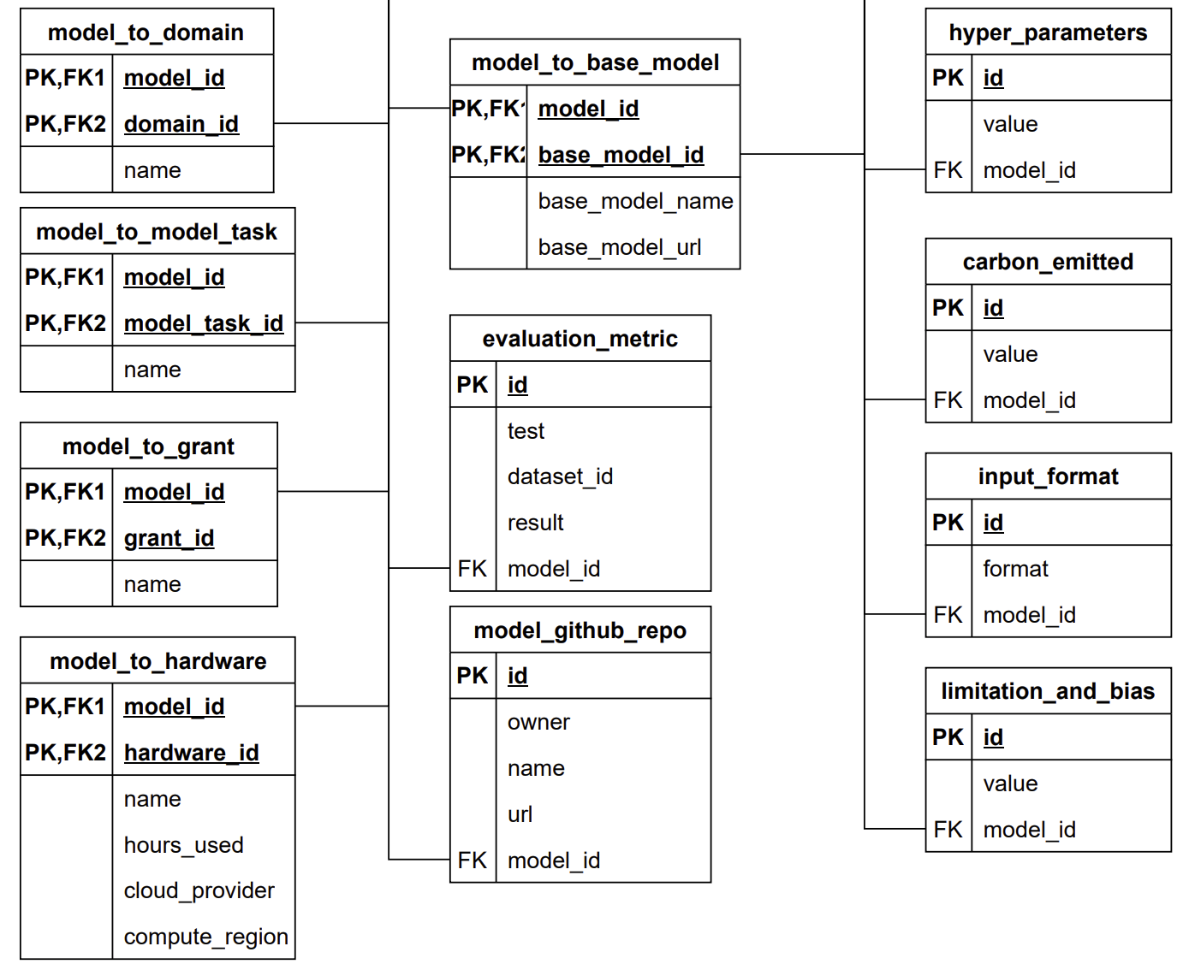
DB Schema - Enhanced PTM Metadata
Enhanced by LLM
Example metadata:
Base/upstream model
Hyper parameters
Carbon emitted
Evaluation metrics
Hardware requirements
Parameter count
Input/output format
…
Notes:
Depending on the model card, not all these information are present
We use a standardized schema so all the data are queryable for further analysis.

Slide 17
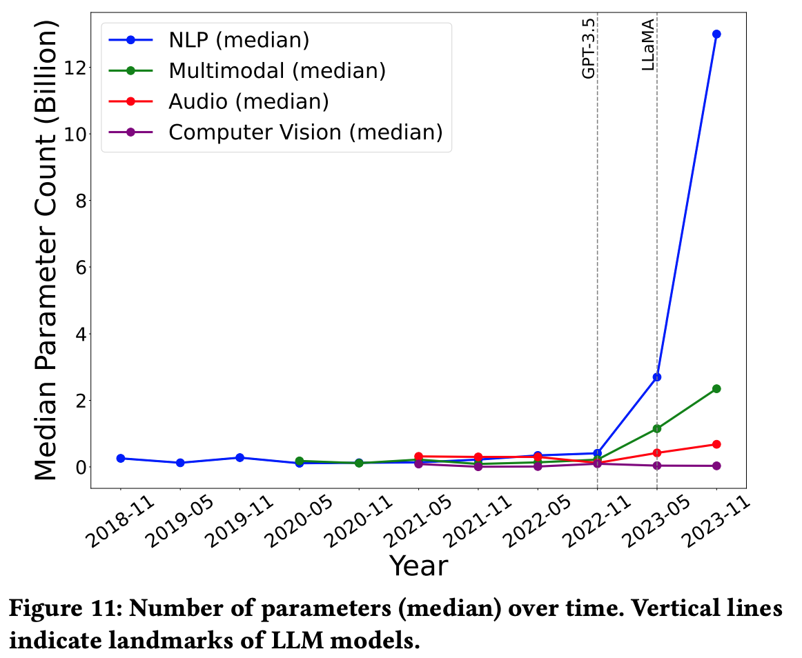
Example Statistics of PTM Supply Chain
NLP and multimodal: noticeably increased after May 2023
Audio and CV: relatively stable
More analysis can be found in our paper!
Notes:
Figure 11 tracks the median model size (i.e., parameter count) by different domain. There is a marked increase in the median size of NLP and multimodal PTMs, especially noticeable after March 2023. Meanwhile, the median parameter count for Audio and CV models has remained relatively stable.

Slide 18
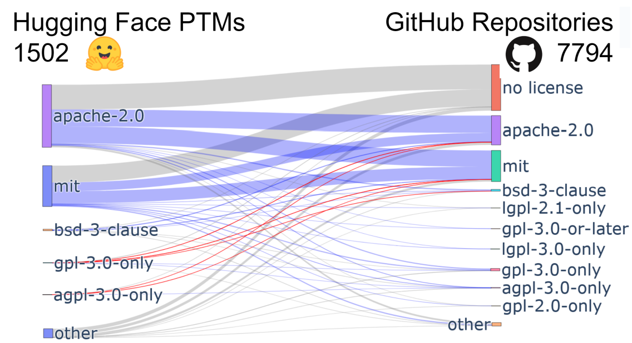
Mining PTM-Application License Compatibility
Excluded
Compatible
Incompatible
Identical: 25.61%
Incompatible: 0.24%
Notes:
Source: Linux Foundation’s OSS license compatibility table
Grey: not included in Linux table
Blue: compatible
Red: incompatible
In 25.61% cases, PTM-App licenses are identical
In 0.24% cases, license are incompatible. There is copyleft provisions in the PTM’s license that are not honored by the Application
Many downstream GitHub repositories (43.42%) choose not to define a license (“no license” in the figure), instead operating under the default posture of Hugging Face (full reuse [48]) and GitHub (much stricter — copyright reserved to author [40]). In 25.61% of cases, the PTM-Application licenses are identical. 0.24%: this is the result of copyleft provisions in the PTM’s license that are not honored by the Application

Slide 19
Future Directions
Notes:
Example lines of research for researchers to investigate, phrased as research questions. These questions are divided into three groups. The first group uses the Pre-Trained Model portion of the dataset (PTM). The second group of questions makes use of the GitHub portion of the dataset (GH). The third group asks questions that require Integrating both parts of the dataset (I).

Slide 20
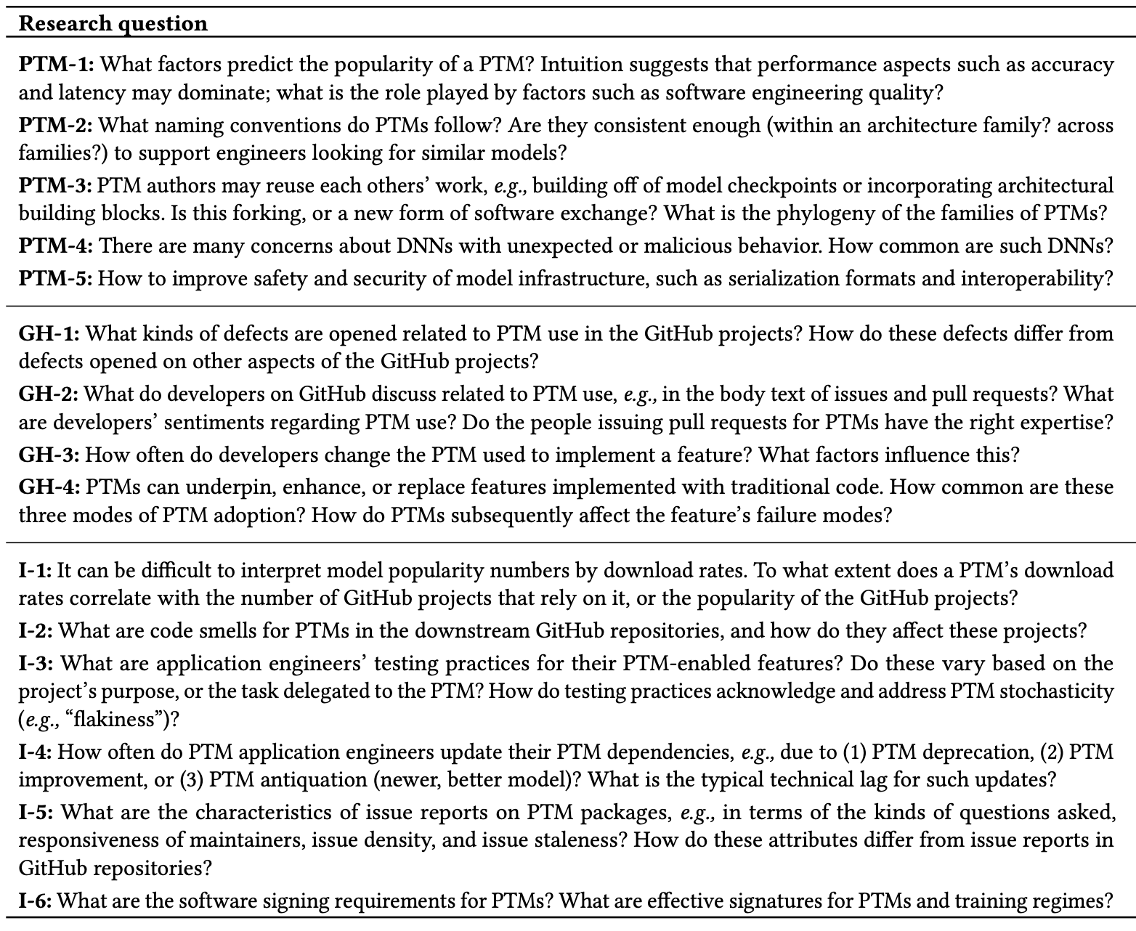
Future Direction on PTM - Overview
We proposed 15 future directions in the paper:
PTM
GitHub
Integration

Slide 21
Future Direction on PTM - Examples
Factors of PTM popularity and quality
PTM naming conventions
PTM
Evolution of PTM features
PTM reuse patterns
GitHub
Testing practices for PTM features
Effective signature for PTM
Integration

Slide 22



Summary
PTM reuse is an emerging form of software reuse
with novel characteristics
We have only scratched the surface of PTM reuse
Let’s research more on PTM packages!
arxiv.org/2402.00699
Contact: jiang784@purdue.edu
Website: wenxin-jiang.github.io
https://github.com/PurdueDualityLab/PeaTMOSS-Artifact
Notes:
In conclusion,
We must ensure its utility (for efficient software engineering), and its security (for everyone)
Let’s research more on PTM packages!
That's all for my talk!
Here are my contact information and our artifact. Thanks for your attention!

